Slide 1


Recurrent auto associative memory
=============================================================================
WWW.THEMLLABS.COM || contact@themllabs.com || Phone : 91-7338339898, 91-6362546088

Slide 2
Agenda
Auto associative memory
=============================================================================
WWW.THEMLLABS.COM || contact@themllabs.com || Phone : 91-7338339898, 91-6362546088

Slide 3
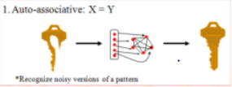
Auto associative memory
Auto associative memory is a memory that enables one to retrieve a piece of data from only a tiny sample of itself.
=============================================================================
WWW.THEMLLABS.COM || contact@themllabs.com || Phone : 91-7338339898, 91-6362546088

Slide 4
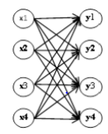
Auto associative memory can recall a stored sequence when they are presented with the fragment or noisy version of it (as we seen in last diagram).
The basic connection is given on the right side.
The inputs are connected to the outputs via
weight w.
=============================================================================
WWW.THEMLLABS.COM || contact@themllabs.com || Phone : 91-7338339898, 91-6362546088

Slide 5
w_{ij} denotes strength of unidirectional connection from ith input to jth output.
x = y in auto associative memories
=============================================================================
WWW.THEMLLABS.COM || contact@themllabs.com || Phone : 91-7338339898, 91-6362546088

Slide 6
Thank you
=============================================================================
WWW.THEMLLABS.COM || contact@themllabs.com || Phone : 91-7338339898, 91-6362546088

